Slide 1
Oil and Grease Resistance Test Methods SNP Inc.

Slide 2
Most common OGR test methods
3M® Kit Test (Tappi T559)
Turpentine Test (Tappi T454)
Permeability Test (ISO 16532-1)

Slide 3
3M® Kit Test
Well-known by paper and board manufacturers and suppliers
Measures the degree of repellency of paper or boards treated with fluorochemical sizing agents
Used to quantify and compare performance of cellulose substrates used for food contact and other packaging applications
Easy, cheap, quick and reproducible

Slide 4
Turpentine Test
Utilizes silica sand in conjunction with dyed turpentine
Time taken for dye to penetrate substrate is then determined
Not always the most suitable method for assessment of cellulose substrates having grease or oil resistance through use of coating or internal treatment

Slide 5
Permeability Test
Determines the grease resistance of both creased and uncreased cellulose substrates by determination of time taken for palm kernel oil (a simulated fat material) to penetrate into fibers
Method is equally applicable to cellulose substrates that have been internally or surface sized with organophobic materials, or plastic coatings

Slide 6
Comparison of OGR Testing Methods

Slide 7
3M® Kit Test Solution Compositions

Slide 8
Surface Tensions of 3M® Kit Test Solutions
Wetting of surfaces by liquid is ruled by
surface tesnion of liquid vs. surface energy of solid
γ_{L} = surface tension liquid
γ_{S} = surface energy of solid
θ = contact angle
Liquid
θ
Solid surface
Liquid wets completely solid if γ_{L} < γ_{S}

Slide 9
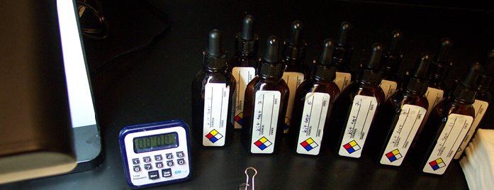
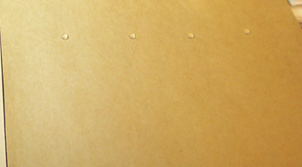
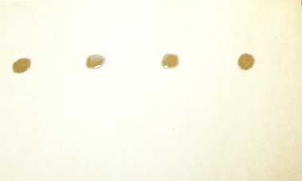
3M® Kit Test
#1
#2
#3
#4
#5
#5
#5
#5
PASS
FAIL
Passed #4, failed at #5. Kit Value =#4.

Slide 10
Problem with Kit Test Use to Predict OGR Performance in Use
It does not always correlate with in-use performance due to the presence of solvents in test solutions
Coatings providing good oil and grease resistance but poor solvent resistance will fail therefore not accurately predicting in-performance use
Does not account for hydrostatic pressure exerted by packaged goods
In-use performance of non-fluorochemical containing coatings and papers can not be predicted by this test method
Foods do not contain solvent

Slide 11
Preparation of Turpentine Test Solution
Prepare colored turpentine test fluid by adding 5 grams of anhydrous calcium chloride and 1.0 gram of a suitable oil-soluble red dye to 100 grams of turpentine in a capped bottle.
Shake well and let stand for at lease 6 hours, shaking occasionally.
Warm solution to approximately 70 deg F.
Filter solution through a dry filter paper.
Place back in air tight capped bottle.

Slide 12
Turpentine Test Procedure
Using a pencil, mark a 72 x 72 inch square on the treated side of the specimen to be tested. The specimen should be free of creases or folds and should be placed a smooth flat surface.
Using a stencil brush apply the turpentine test solution to the specimen.
Start timer and time 60 seconds.
Wipe surface and count # of pinholes present. Test at least 6 specimens and report maximum and minimum of pinholes observed.

Slide 13
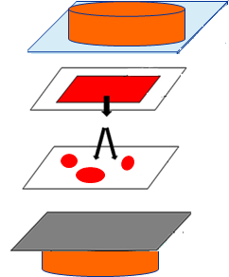
Permeability Test-TAPPI T-507
Pressure block 720g
Oil Indicator
The prepared paper 100mm x 100mm
Saturated blotting paper 75mmx75mm
Clean blotting paper 100mm x 100mm
Aluminum foil 100mm x 100mm
Pressure block 720g

Slide 14
Hot Mazola Test Procedure
Weigh specimen on balance with accuracy of 0.001g or better.
Set-up and test as if running a Cobb test (TAPPI T-441), except replace water with corn oil.
Place specimen in a 110 degree C oven for 20 minutes.
After 20 minutes, remove from oven and pour off oil.
Remove specimen from Cobb tester.
Place two standard blotter sheets over specimen and remove excess oil by moving a roller having a smooth face 20 cm wide and weighing 10.0 ± 0.5 kg (22 ± 1.1 lb) over its surface.
Reweight the specimen and calculate the amount oil absorbed/unit area of the test specimen.
**Note if staining is observed. If oil penetrates specimen mark as failed.

Slide 15
Oleic Acid Test Solution Compositions
Test Composition (%w)
Solution # | %Castor Oil | %Oleic Acid | %Octanoic Acid
1 | 100 | 0 | 0
2 | 50 | 50 | 0
3 | 30 | 70 | 0
4 | 0 | 100 | 0
5 | 0 | 80 | 20
6 | 0 | 70 | 30
7 | 0 | 55 | 45
8 | 0 | 35 | 65
9 | 0 | 20 | 80
10 | 0 | 10 | 90
11 | 0 | 0 | 100

Slide 16
Procedure
Place specimen inside a preheated 60 degree oven on a flat surface with side to be tested facing up.
Without touching dropper to the surface of the paper, place one drop of each test solution onto the surface of the paper. Drop height should be 1-2 cm.
Close the oven and start timer.
After 6 min, remove sample from oven and wipe excess reagent from the surface with an absorbent material.
Evaluate the surface of the sample at each drop placement area and note if penetration, dark staining, or pinholes are observed.
Record highest # reagent that did not cause failure (penetration).
Record highest reagent# for which no visual staining was observed.
Report presence of pinholes as “Yes” or “No”.

Slide 17
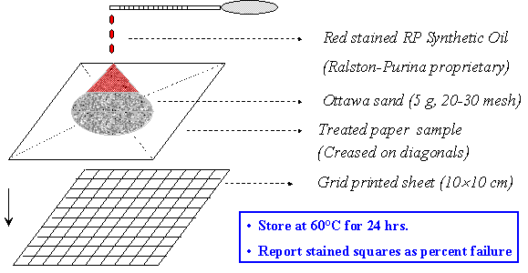
RP-2 OGR Performance Test
Red stained RP synthetic oil (Ralston-Purina proprietary)
Ottawa sand (5g, 20-30 mesh)
Treated paper sample
(Creased on diagonals)
Grid printed sheet (10x10cm)
Store at 60 C for 24 hrs.
Report stained squares as percent failure.

Slide 18
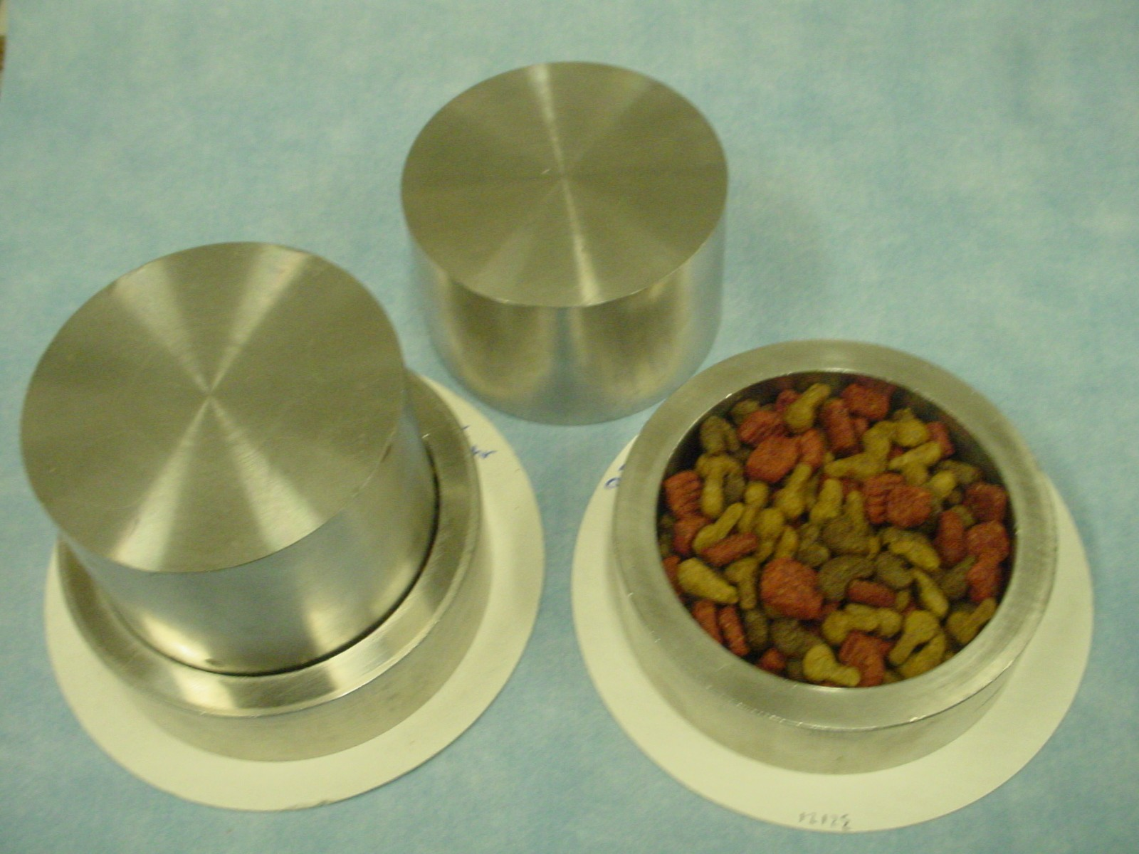
Pet Food Performance Test
Conditions:
Temp. = 60-70 °C
R.H. = 50-65%
Duration = 16-24 hours
Report results as % stained surface

Slide 19
Surface tension values of liquids and surfaces
Surface tension (dynes/cm)
Values detected at 20°C
Untreated paper ⁽¹⁾
40 - 50
31-32
Cooking oil ⁽²⁾
Natural fats and oils
27-28
Free fatty acids ⁽²⁾
Ideal CF2 coverage
18
-CF2- sequence (PTFE) ⁽³⁾
Ideal CF3 coverage
6
CF3 monolayer ⁽³⁾
Source: (1) Borch J., J. Adhesion Sci. Technol., 5(7), 523 (1991(; (2) Solvay Solexis internal data (3) Zisman W.A., Contact Angle, Wettability and Adhesion, Advances in Chemistry Series, Vol 43 (1964) and refs. teherein

Slide 20
Paper Wetting Mechanisms by Oils/Fats

Slide 21
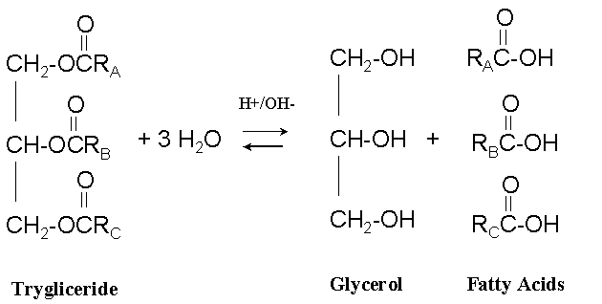
Fats/Oils Chemical Structure
Low polarity/Low reactivity
R = C6 to C22
Polarity/Reactive groups

Slide 22
Parameters Affecting Oil Adsorption
A) Non-polar, non-reactive oils
- surface energy of treated paper vs. liquid surface tension - solubility effects
- capillary adsorption contribution
B) Reactive, polar oils
- polar interaction with paper constituents
*Both mechanisms need to be considered when formulating a coating
to meet application requirements

Slide 23
Oils and Fats Composition
Fatty acid composition of natural oils and fats (contained as tryglicerides)

Slide 24
Fatty Acids Penetration
How do different carbon chain lengths in Free Fatty Acids (FFA) affect penetration?
Penetration through the coated substrate is related to the carbon chain length.
The greater the number of lower carbon chain free fatty acids will result in more aggressive penetration of FFA.

Slide 25
Free Fatty Acids in Packed Materials
Pet Foods
Generally containing from 10 to 27% crude fat
Crude fat contains 10 to 30% FFAs by weight
FFAs in pet-food materials can range from 1 to 9%
Butter
W/O emulsions
Triglycerides hydrolysis takes place
Chicken Fat
May contain up to 10% FFA

Slide 26
FFA Alternative to Kit Test

Slide 27
Test Solutions: 5 Fatty Acids Mixtures
Test fluids increase in aggressiveness as percent of shorter chain FFA increase
Unlike kit solutions, there is little variation in surface tension of fluids over time

Slide 28
Benefits of Test Method
Test fluids are more reflective of what will be seen in use.
Test fluids contain no solvents.
Temperature of 60C can be used to accelerate test results.
Test fluids are stable over time.

Slide 29
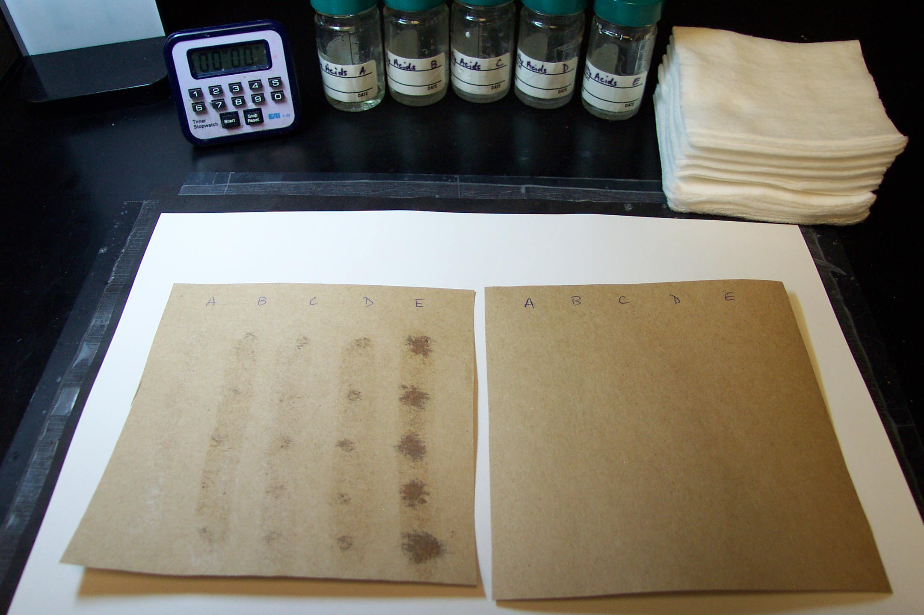
Fatty Acid Test Procedure
Apply test fluids in same manner as kit solutions.
Keep mixtures in oven at 60°C prior to use.
Place sample with test fluieds in oven at 60°C for 10 minutes.
Remove from oven and observe staining.
Paper is rated with the # of highest mixture that does not stain.
Fail
Pass

