Slide 1
Hybrid Polysaccharides Application and Performance
SNP Inc.

Slide 2
In this Presentation
Hybrid Polysaccharides
What are they?
What are their benefits?
Applications: Types and Processes
SNP Inc. Hybrid Offerings
Cost/performance benefits
Review and Conclusions

Slide 3
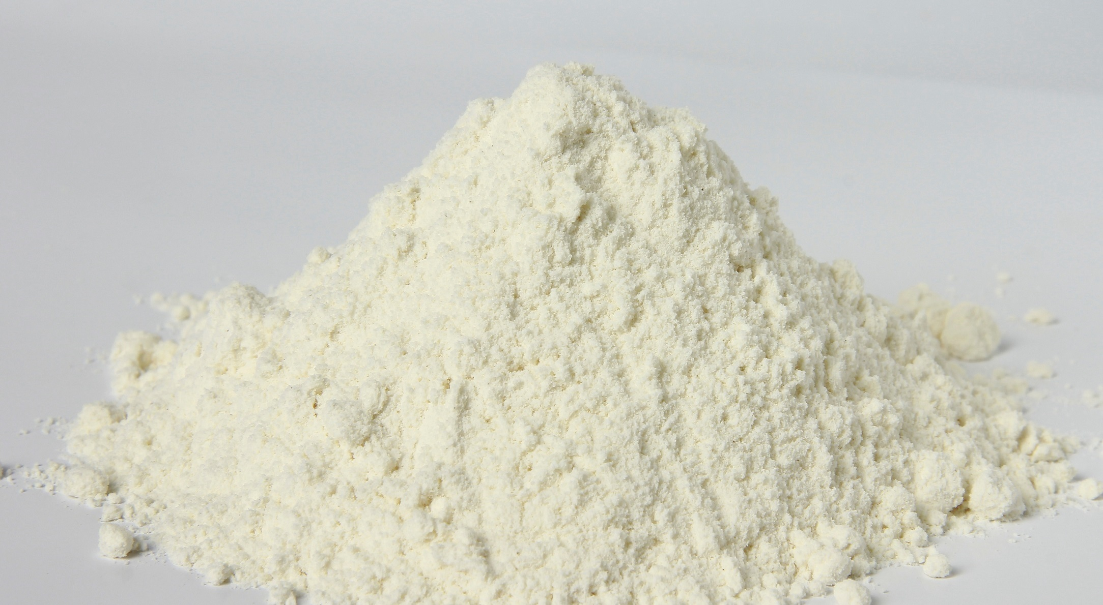
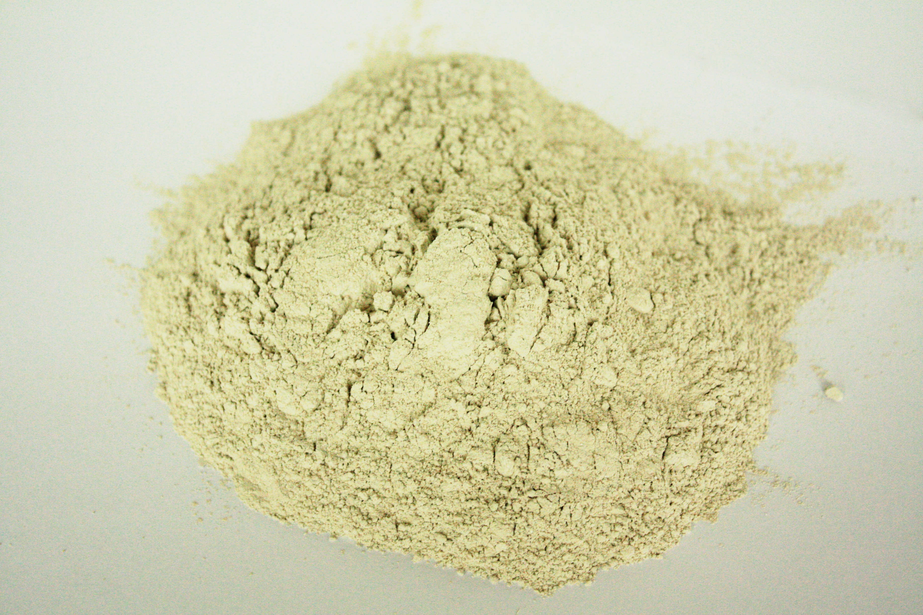
Hybrid Polysaccharides: Overview
A polysaccharide is a carbohydrate (e.g., starch or cellulose) whose molecules consist of a number of sugar molecules bonded together.
Numerous factors such as molecular weight, chain length, and the atomic make-up of the polymer will impact the final properties of a given polysaccharide.
A hybrid polysaccharide is made by blending two or more polysaccharides.
Hybrid polysaccharides provide the ability to balance performance and cost.
Hybrid polysaccharides can provide unique properties due to synergistic effects, providing properties unobtainable utilizing any singular material component.
SNP Inc’s technical experts have developed a line of hybrid polysaccharides and can develop products to meet your specific needs.

Slide 4
Hybrid Polysaccharides: Balancing Cost & Performance
Product | pH Stability | Thickening Efficiency | Cost
Hydroxy Ethylated Cellulose (HEC) | +++ | + | ++++
Carboxy Methylated Cellulose (CMC) | + | + | ++
HEC+CMC Hybrid | ++ | +++ | ++
Xanthan Gum | +++ | +++ | ++++
Guar Gum | +++ | ++ | +
Xanthan+Guar Hybrid | +++ | ++++ | ++(+)

Slide 5
Hybrid Polysaccharides: Achievement of Synergistic Properties
Material | Viscosity (cPs)
Guar | 3,210
Xanthan | 1,070
Guar+Xanthan | 3,750
CMC | 3,385
HPG | 98,652
CMC+HPG | 121,562

Slide 6
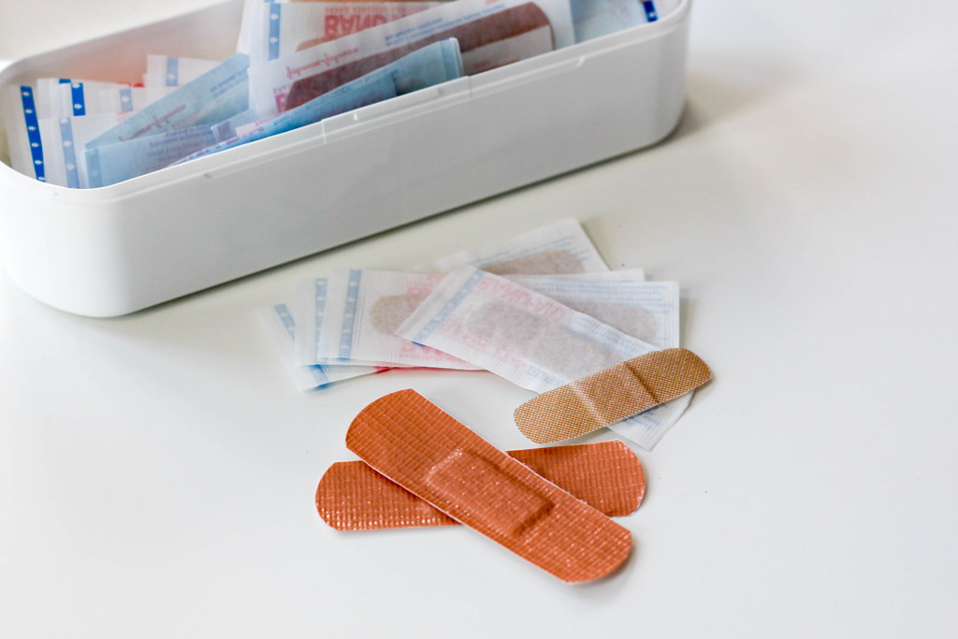
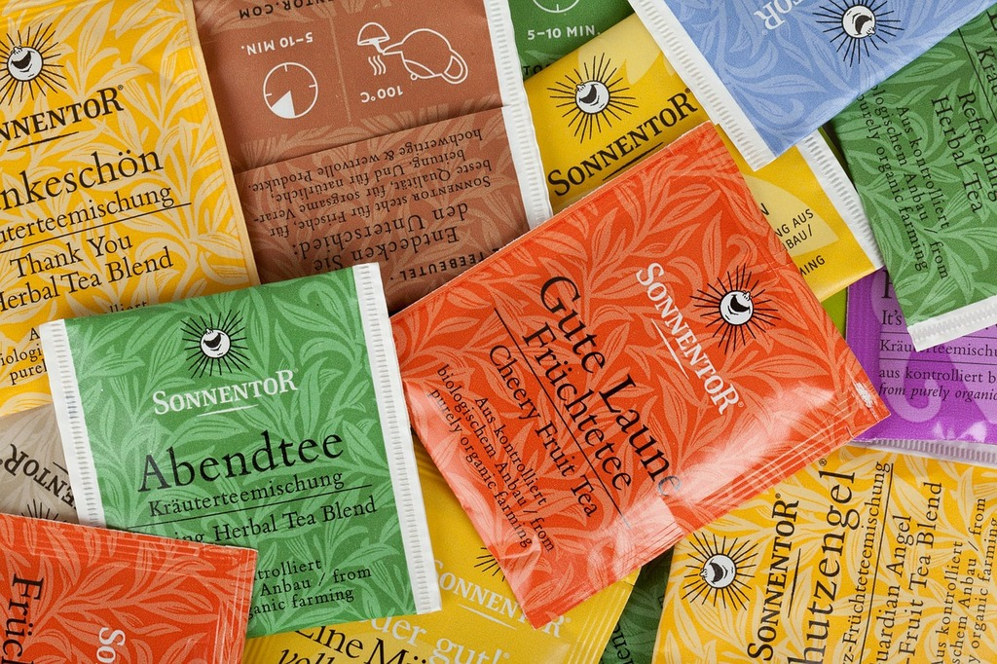
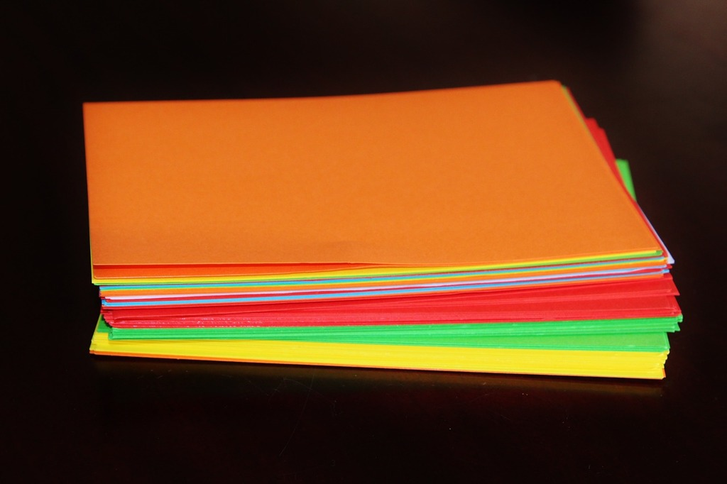
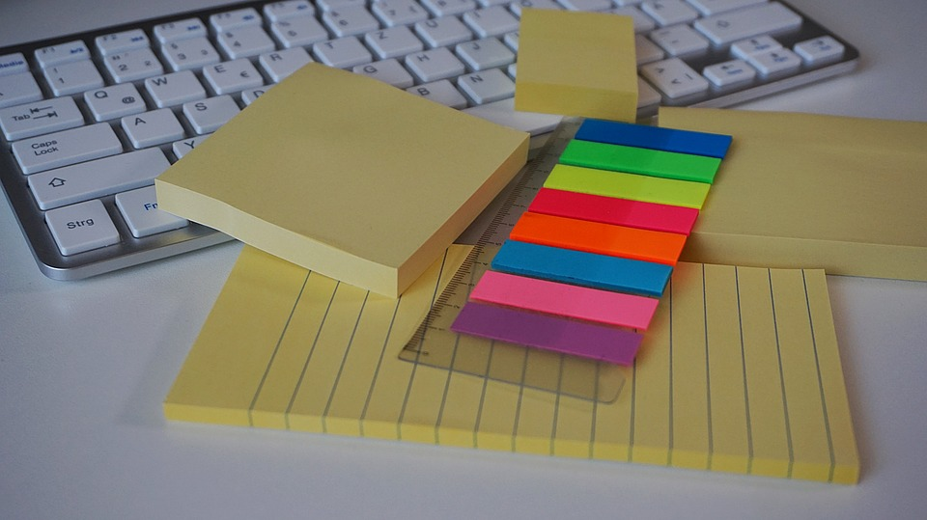
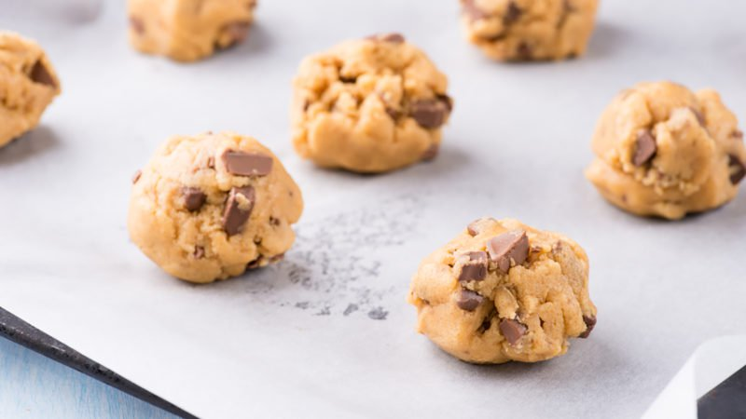
Hybrid Polysaccharides: Application Types
Release Paper Markets: medical, composites, graphics, tapes, labels, industrial, and hygiene.
Consumer Packaged Goods: food, beverages, cosmetics, cleaning products, electronics.
Printing and Writing: inkjet, laser, gravure, flexo, litho, bond, book, text.
Specialty: card, board, art
Notes:
Individual market segments will utilize different coating/substrate materials to meet the specific requirements for the intended end-use. Differences in substrate composition (i.e., paper, paperboard, plastic, and non-wovens) require different coating methods and materials. These difference between the process and product needs of each market are fully understood by SNP’s technical experts who work to help meet our customers specialty needs.

Slide 7
Hybrid Polysaccharides: Application and Processes
Internal Sizing
Surface Sizing
Surface Coatings
Rheology Modification
Oil and Grease Resistance

Slide 8
SNP Inc’s Line of Hybrid Polymers
SNP Inc. has the ability to custom blend a range of industrial polysaccharides including:
Guar Gum
Xanthan Gum
Sodium Alginate
Carboxymethylated Cellulose (CMC)
Hydroxy Ethylated Cellulose (HEC)
And more!
SNP will work with you to understand your cost performance needs and will customize a product to meet your needs.

Slide 9
Review and Conclusions
Hybrid polysaccharides can help achieve cost/performance requirements for a range of applications and processes.
Hybrid polysaccharides can be formulated to provide synergistic properties unobtainable by any single component.
SNP can make a custom product to meet your industrial application needs.
Contact SNP Inc. today to learn how we can help you meet your project goals.

